Slide 1
HOUSE PRICE PREDICTION

Slide 2
PROBLEM STATEMENT AND UNDERSTANDING
House is a basic need of every humans, not only humans every other livings, therefore housing and real estate market is one of the markets which is one of the major contributors in the world’s economy. It is a very large market and there are various companies working in the domain. Data science comes as a very important tool to solve problems in the domain to help the companies increase their overall revenue, profits, improving their marketing strategies and focusing on changing trends in house sales and purchases. Predictive modelling, Market mix modelling, recommendation systems are some of the machine learning techniques used for achieving the business goals for housing companies. As we have some features among house, we want to look on deep which feature will effect the price of the house. This what we want to do on this project.

Slide 3
EDA steps and visualizations

Slide 4
EDA Steps
Dataset have 1460 entries and 81 variables.
Dataset have some null values I have treated them I efficient way.
Numerical features treated with ‘mean’ and categorical features with ‘mode’ respectively.
Some features have above 80% of null values so I have dropped the feature because it may not affect for our prediction.
And a feature ’Utilities’ have only one value so I decided to drop it. It also not affect for prediction.
Now I make a list of categorical and numerical features separately and check the hoe it is related to the dependent variable price of the house.
Selecting all categorical features and apply label encoder.
Features scaled

Slide 5
And also I separated the continuous and discrete in numerical features and check their relation between features and the price of the house.
The features like the year in which the house built is affecting the price.
When come to outliers we can detect some outliers, while removing outliers there is a big loss in data.
When check the correlation of the features to target variable price, month of sold have less correlation so I decide to drop it.
The all same EDA steps performed in test dataset as same as in train dataset.

Slide 6
Visualizations

Slide 7
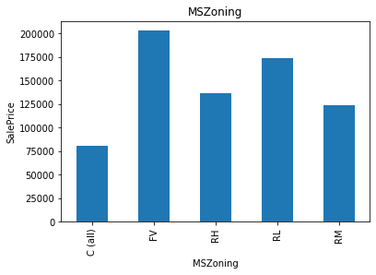
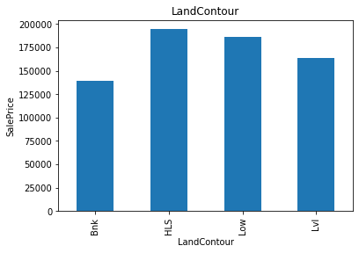
Categorical Features Visualizations

Slide 8
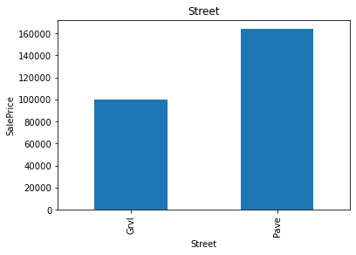
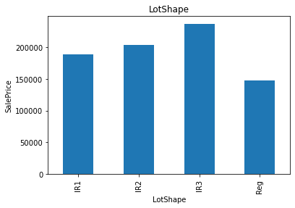

Slide 9
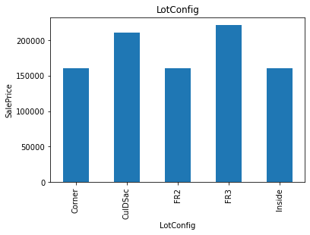
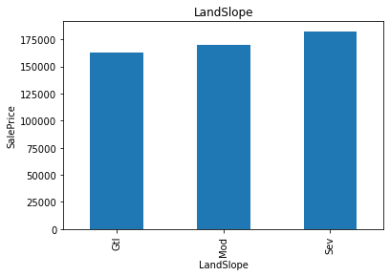

Slide 10
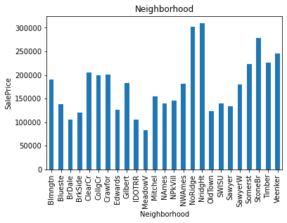
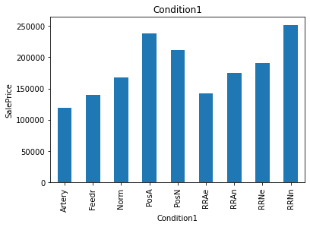

Slide 11
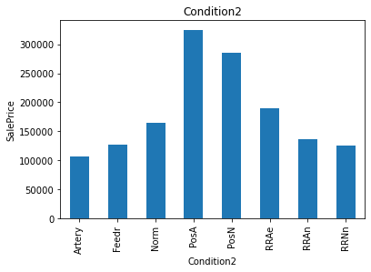
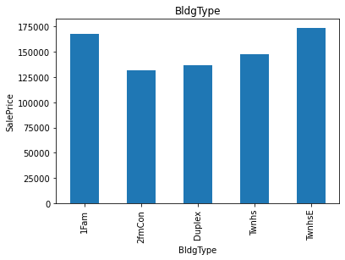

Slide 12
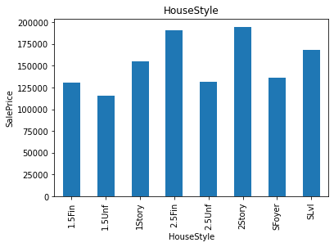
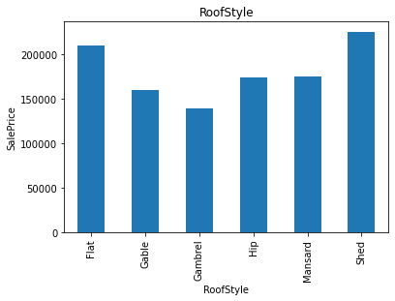

Slide 13
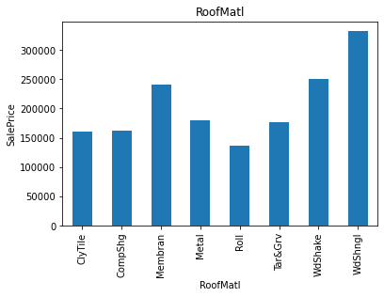
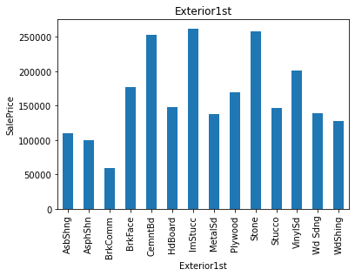

Slide 14
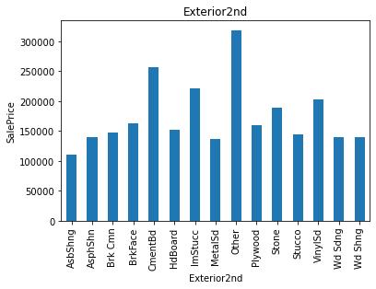
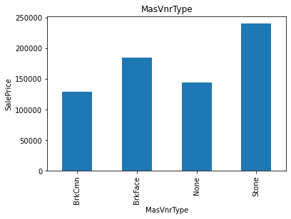

Slide 15
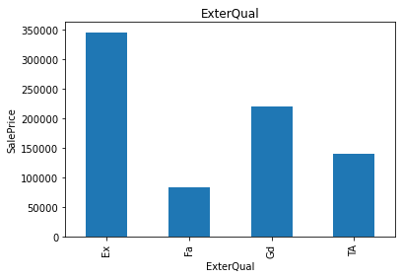
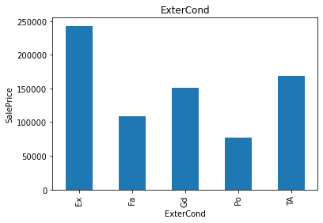

Slide 16
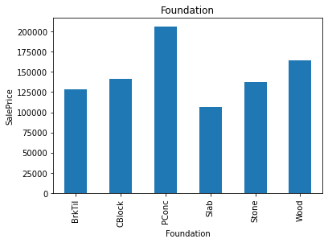
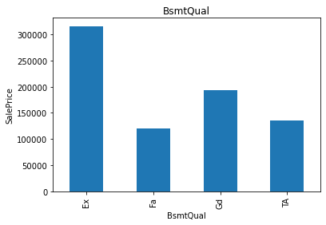

Slide 17
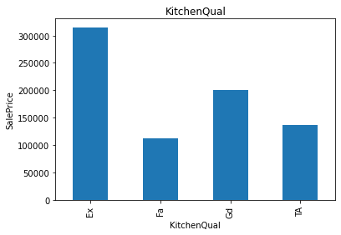
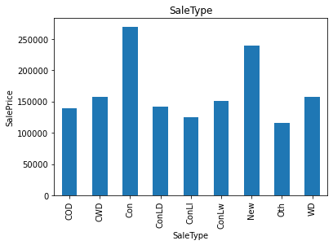

Slide 18
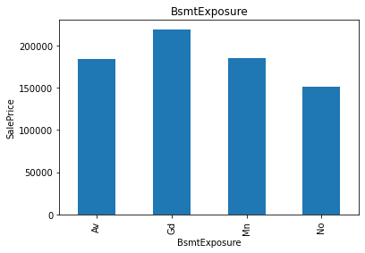
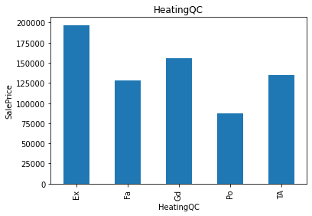

Slide 19
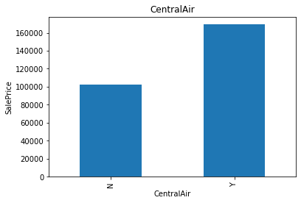
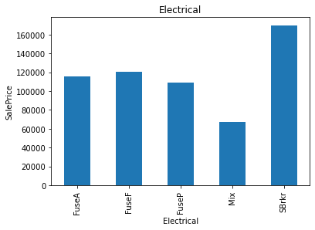

Slide 20
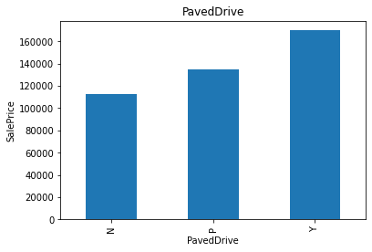
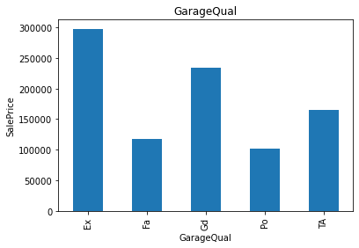

Slide 21
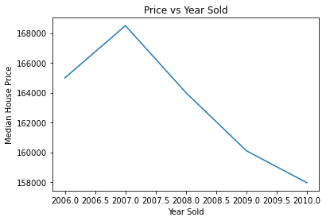
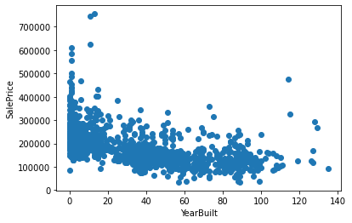
Year features

Slide 22
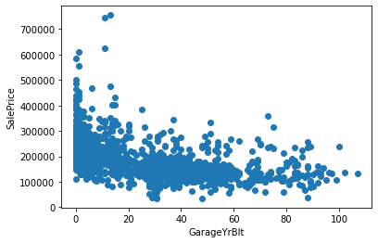
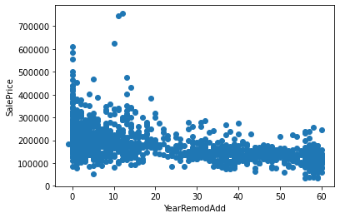

Slide 23
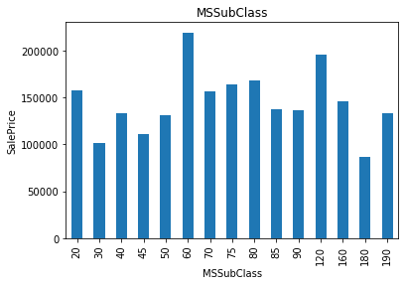
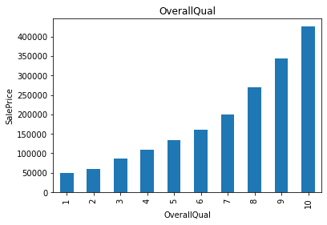
Discrete Features

Slide 24
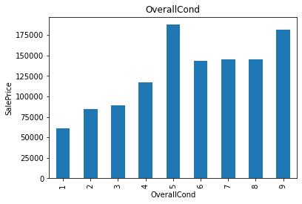
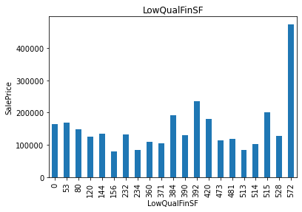

Slide 25
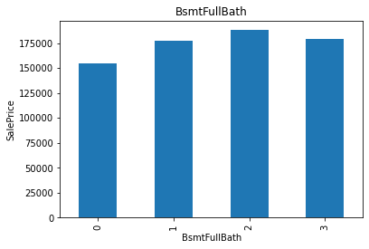
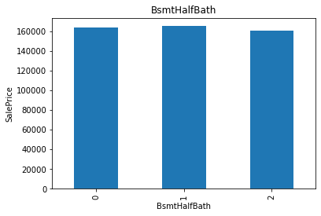

Slide 26
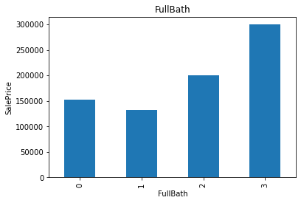
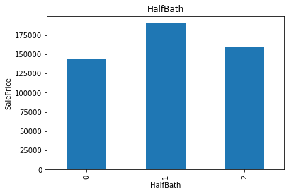

Slide 27
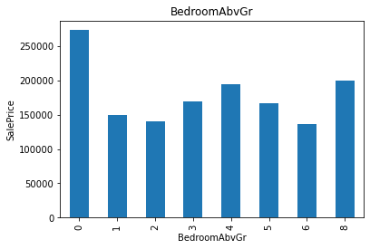
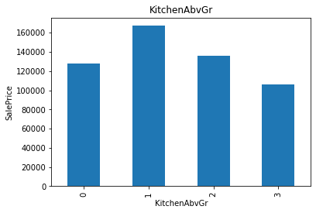

Slide 28
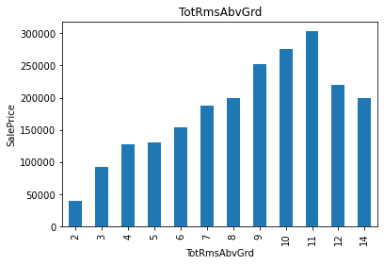
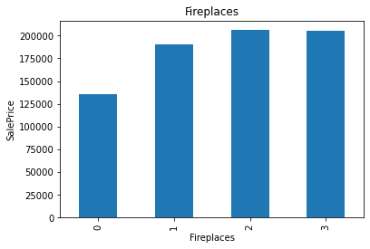

Slide 29
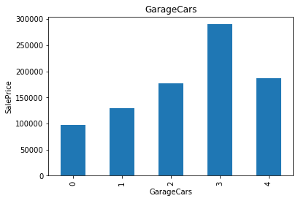
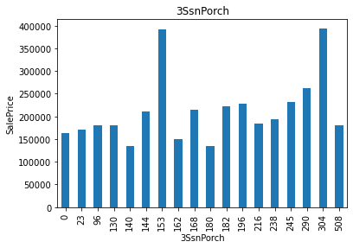

Slide 30
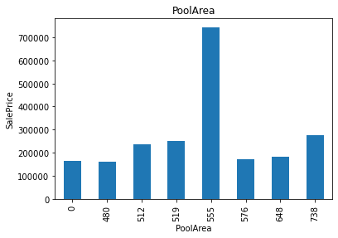
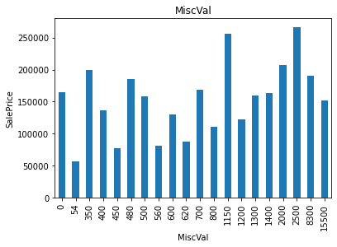

Slide 31
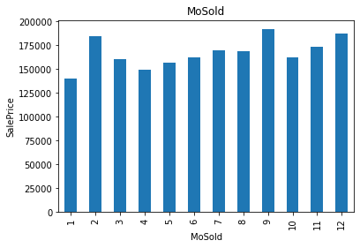

Slide 32
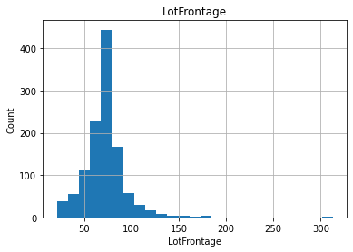

Continuous Features

Slide 33



Slide 34

Here I only take few visualizations of distributions of continuous features.

Slide 35

Outliers

Slide 36

Correlation

Slide 37
STEPS AND ASSUMPTIONS

Slide 38
House price depends on the year of the house which it is built, when the house is too old the price get low in the market.
And also the modification of the house within the year of sold and the year when the house built.
When the house is too old, it may not be safety for people live in there.
And also the surroundings of the house what are the things surrounded by the house, it may include the basic needs like grocery shops, hospitals such needs.
These needs affects the price of the house.
The way or path to house how good it is demands price.
Such as paved way have high demands in price other than gravel paths.
Gravel paths have high possibility of falling and the vehicle can easily pass through that path so it affect the price.

Slide 39
Quality of kitchen, basements, bedrooms, bathrooms attached or common, office rooms are also impacts in price of the house.
As in the given data I observe that the houses with high basement quality have high price in market.
In the data the year o garage built is impact the price of the house.
Material to built the house, condition of roof tops, exterior coating or covering with protection of the house from the climate, these features are also impacts the price.
In my perspective the overall quality of the house is more impacts the price of house.
It includes the overall material and finish of the house.
Materials on the roof, masonry veneer type, exterior material quality, condition of the material used in exterior at the time of selling also impacts the price.
So these features affects the price.

Slide 40
Model Dashboard
Here I used four different model and regularization technique lasso regression.
Linear regression, decision tree, random forest and Xgboost are other models.
Here I check the cross validation score and R2 score of each model to select and finalize the model.
And after checking that random forest have least difference between cross validation and R2 score.
After that tuned and select best parameters of random forest.
Apply the best parameters and find the r2 score.
Here we have less data so accuracy should be less more data gives the best accuracy.

Slide 41
Conclusion
As the population is increasing in the world it demands the house and land.
In future people are going to live in mars, because people have no enough place to live in earth.
Any way it is in future, but now the house have demands. It is basic feature of human lives.
In my conclusion, by analysing the data, the main feature affects the house price is year when it is built. The difference between the year of built and selling year increases the price of the house decreases.
House which have high quality garages have also high demands.
So try to have the features mentioned before in the house before selling for getting high price.

